Slide 1
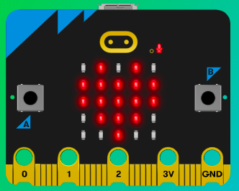
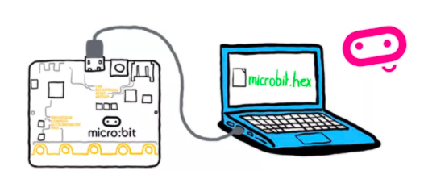
MicroMakers!
KIDS’ MAKER CLUB OF WASHINGTON, DC
Meet Up #1

Slide 2
WELCOME!
Let’s Get to Know Each Other

Slide 3
INTRODUCTION
Micro:what?

Slide 4

Notes:
The micro:bit is a pocket-sized computer that introduces you to how software and hardware work together.

Slide 5
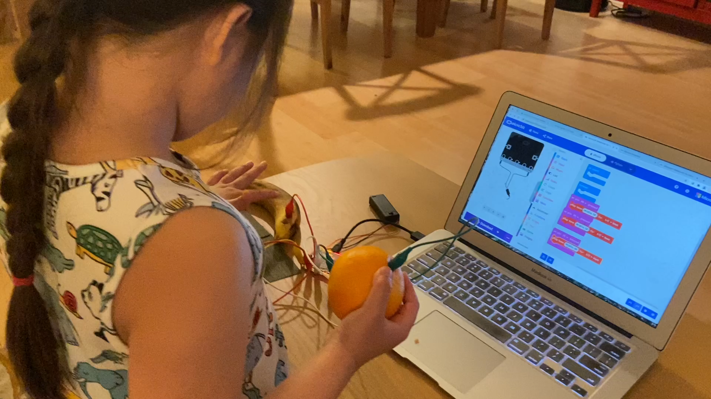
Notes:
Here’s an example of what we will make!

Slide 6
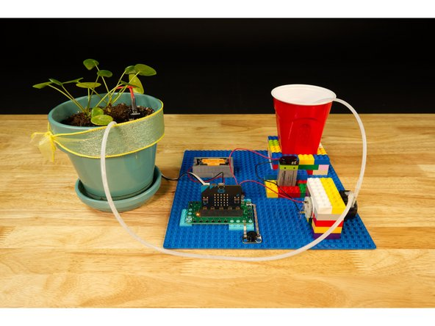
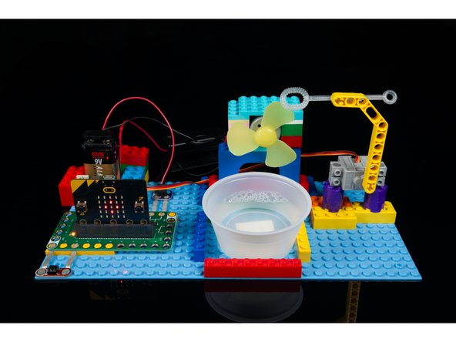
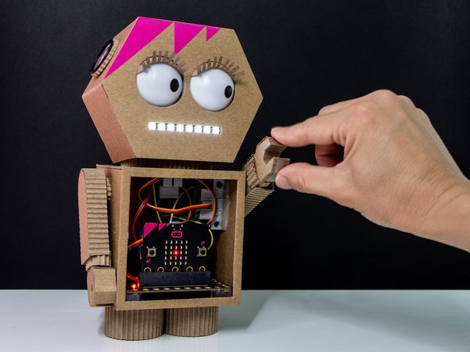
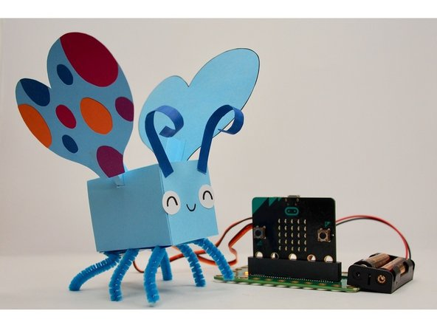
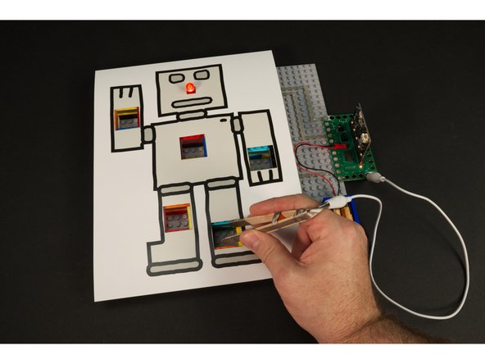
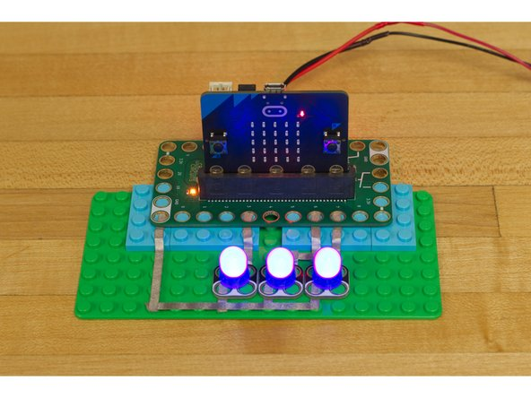

Slide 7
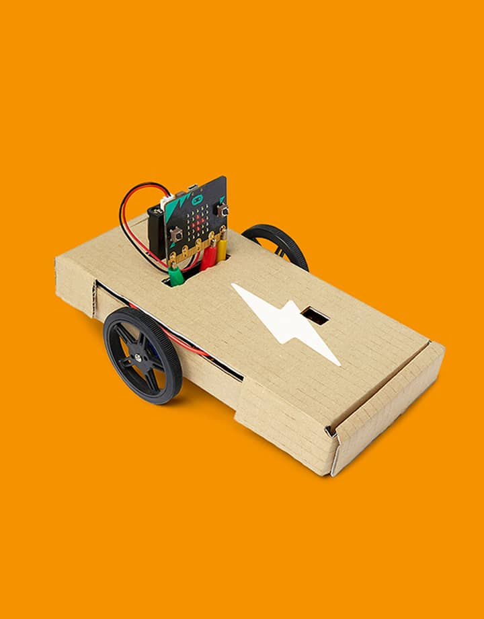
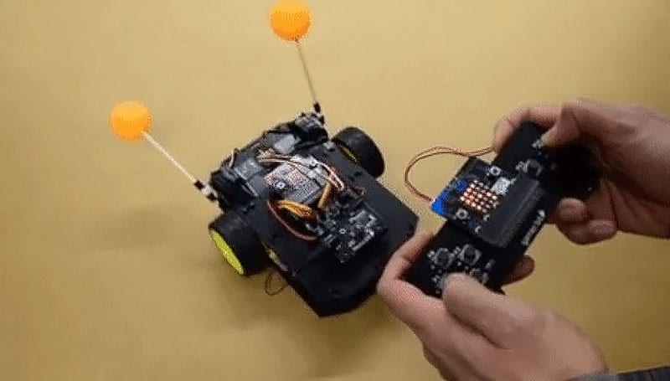

Slide 8
HOW COMPUTERS WORK
Input -> Output

Slide 9

Notes:
The micro:bit helps us understand how computers work. When we type on our laptops or touch the screen on our phones, we’re using an input device. Inputs allow computers to sense things happening in the real world, so they can act on this and make something happen, usually on an output like a screen or headphones.

Slide 10

Notes:
In between the input and the output, there is the processor. This takes information from inputs like buttons, and makes something happen on outputs, like playing a song in your headphones.

Slide 11
Programming
Turning Inputs into Outputs
Processor = ??
Inputs
Program
Output

Slide 12
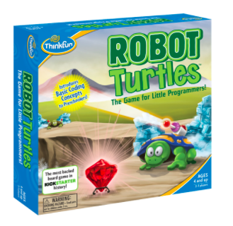

Programming
Let’s Try It!
You tell computers like the micro:bit what to do by giving them instructions. Sets of instructions for computers are called programs. Programs are written in code, a language that both you and the computer can understand.

Slide 13
EXPLORING OUR MICRO:BITS
Slowly and carefully!

Slide 14
Exploring our Micro:bits
Slowly and carefully, now!
Caring for our micro:bits
Identifying the inputs, outputs, and processor
Turning the micro:bit on and off
Trying out some inputs and outputs
Buttons
Touch-sensor
Accelerometer
Microphone
Light sensor
Inserting and removing the USB cable
Inserting and removing the battery pack
How to put away the micro:bit for next time

Slide 15
LET’S GET SET UP
Exciting!

Slide 16
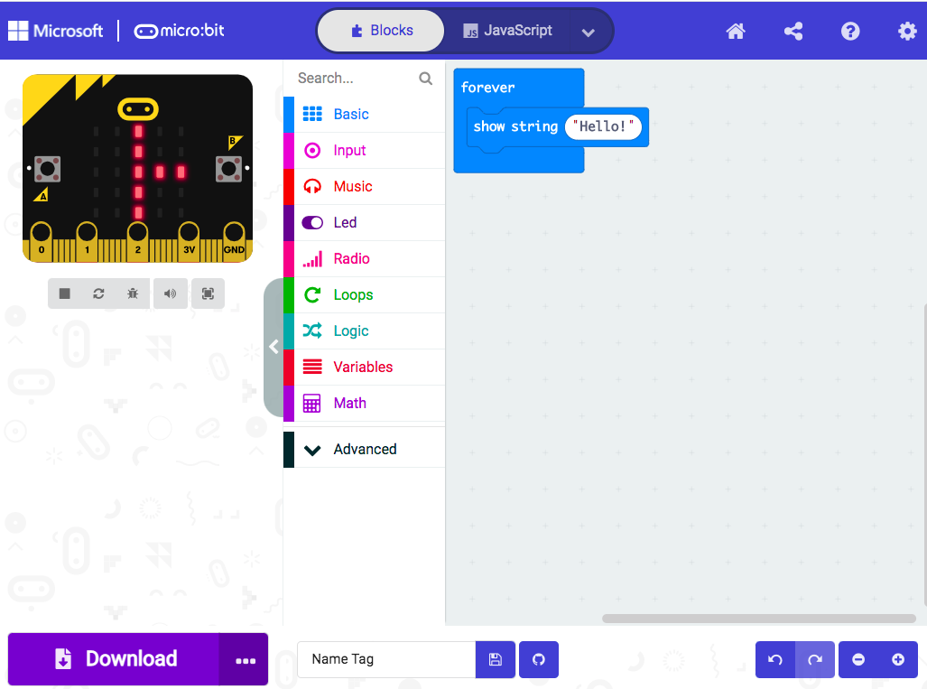
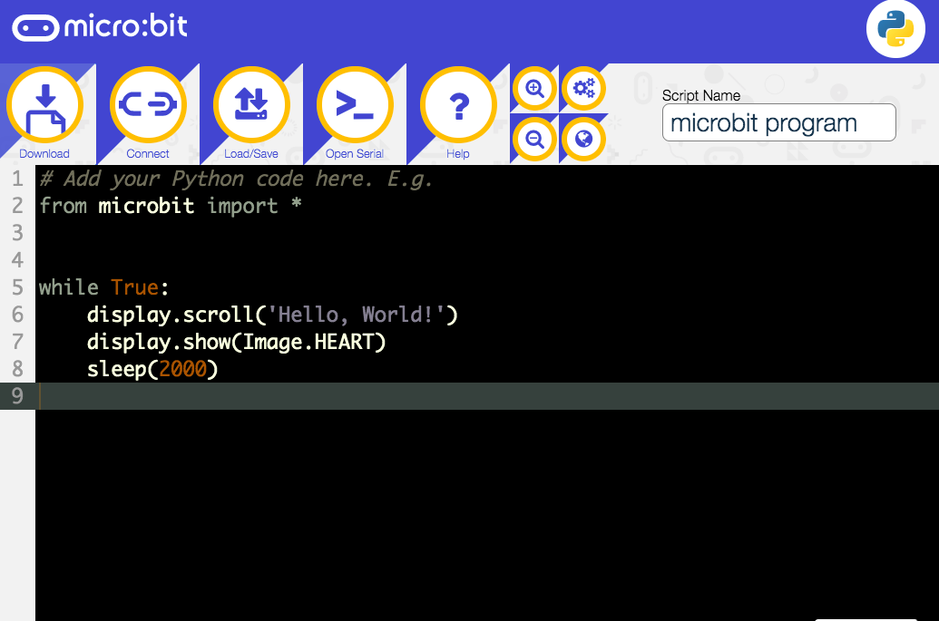
Programming
MakerCode vs. Python
We can program our micro:bits in the online MakeCode block or Python text editors.

Slide 17
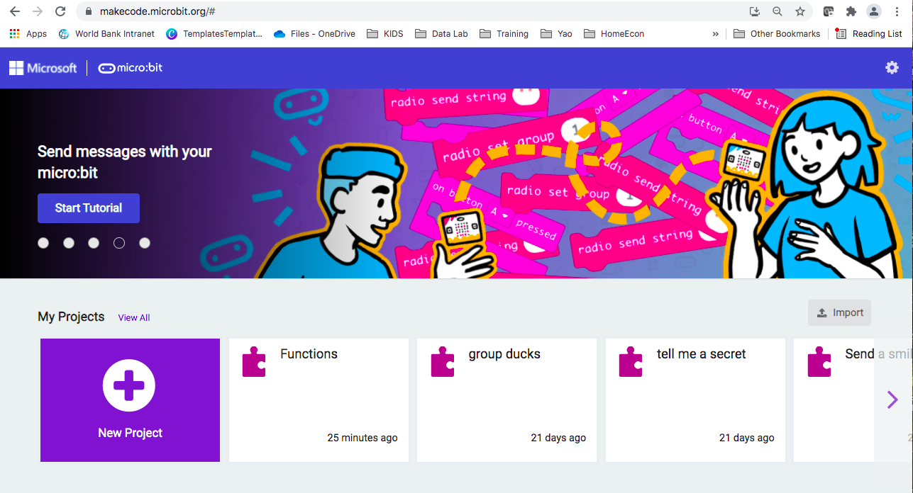
https://makecode.microbit.org/

Slide 18
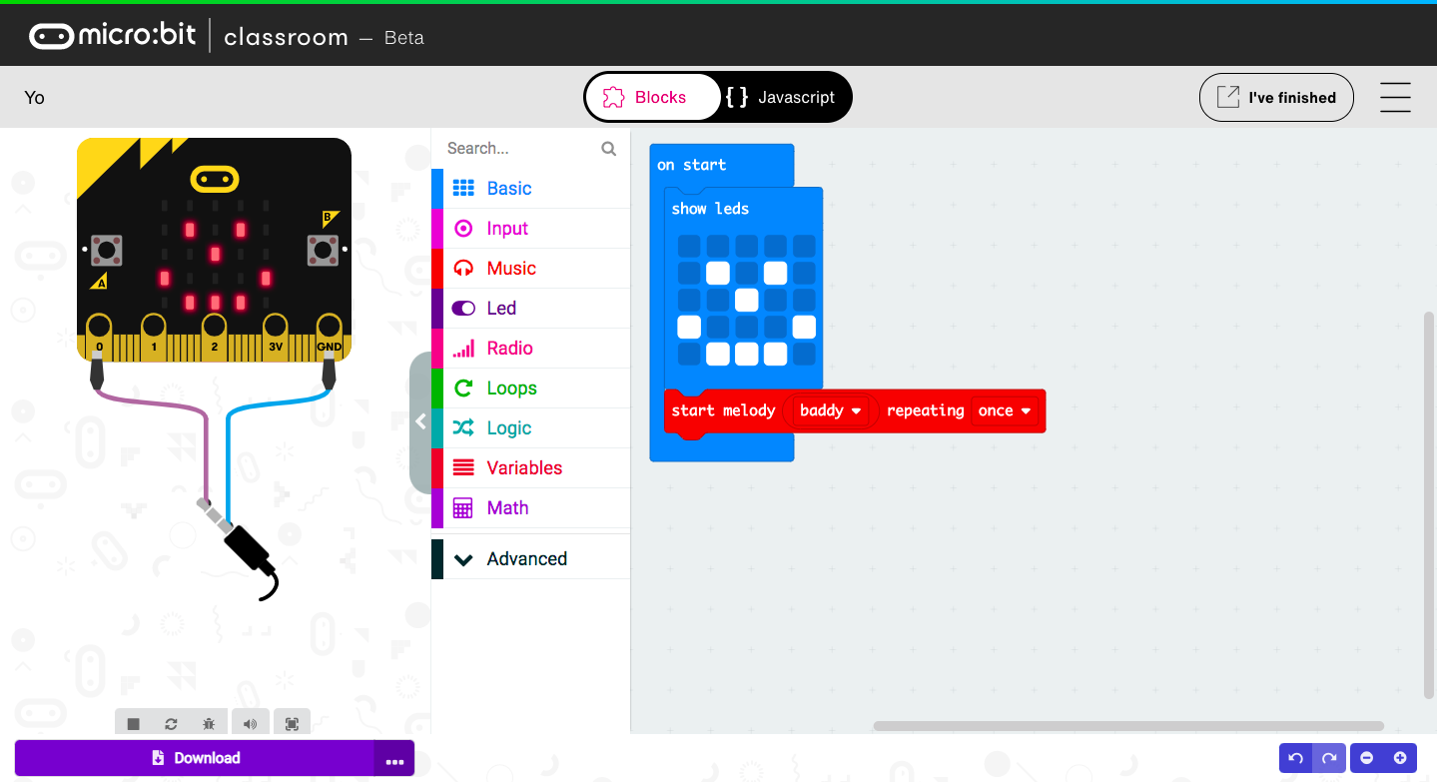
Notes:
Color Coding

Slide 19
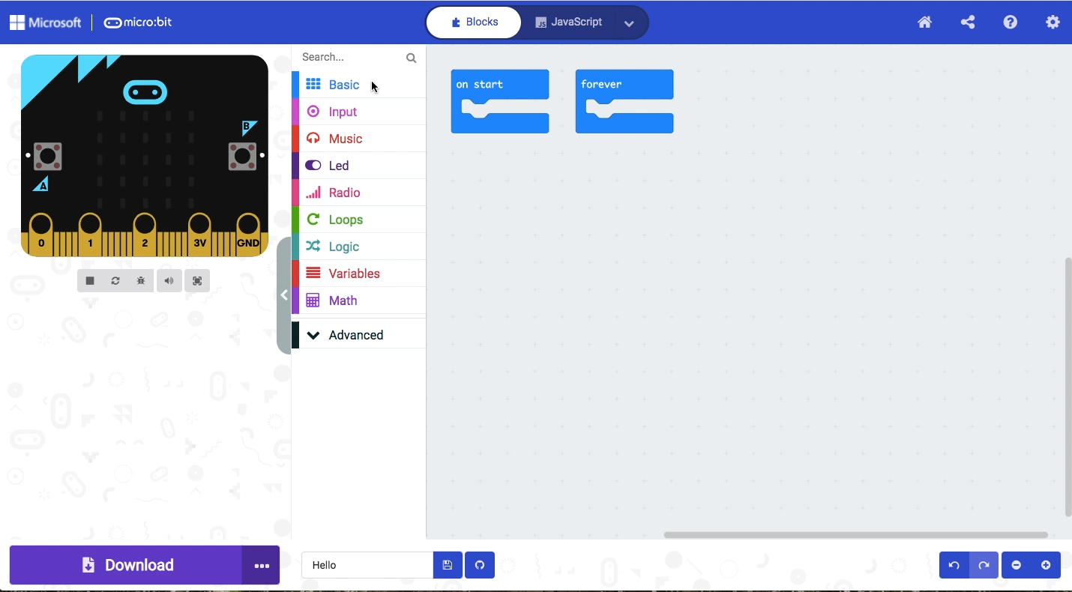
Notes:
Color Coding

Slide 20
Transferring Our Programs to the micro:bit
By using ”direct flashing”
We can send programs direct from the online code editors to our micro:bits without the need to download and copy a .hex file. This is quick and easy.
Note: direct flashing is quick and easy, and is great for debugging, but it does not save a copy of our programs on our computers. If keeping a copy of our code on our computers or local network drives is important, just remember to download and save a .hex file when you have completed your project.

Slide 21
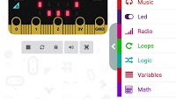

Slide 22

SKILL BADGE
Transferring Programs to Your Micro:bit
YOUR MISSION
Have your micro:bit show a smiley face when you turn it on. Transfer your program to your mico:bit, following the instructions just provided!

Slide 23
TIME TO PUT AWAY OUR MICRO:BITS!
Neat and tidy, please!
Let’s leave this beautiful room as lovely as we found it!

Slide 24
NEXT TIME
Playing with Inputs and Outputs!

Slide 25
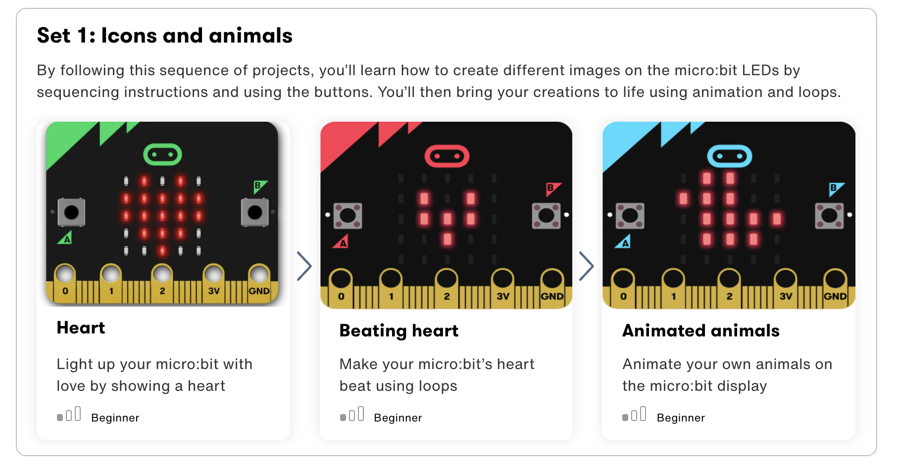

Slide 26
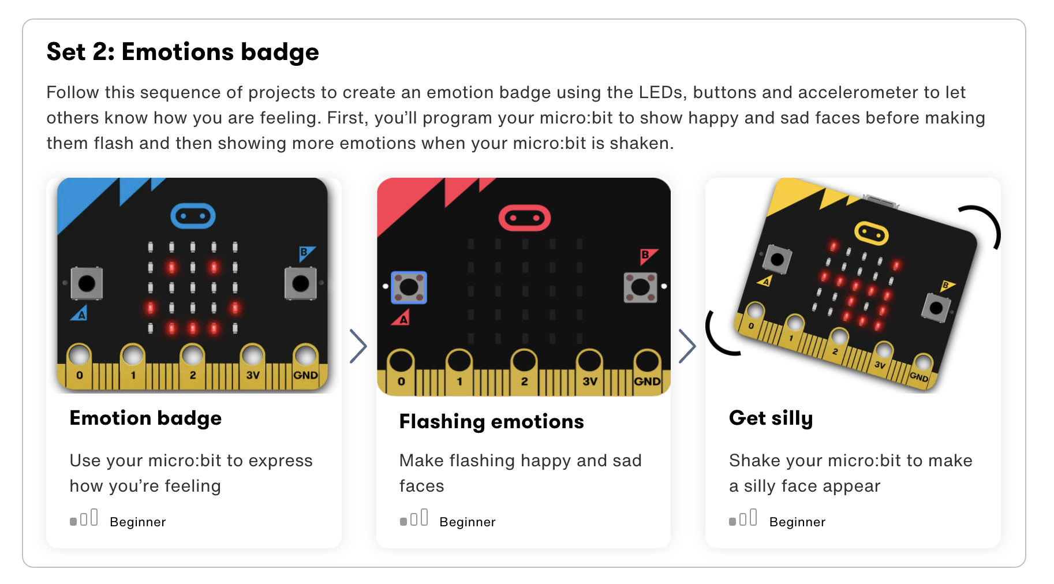

Slide 27

UNTIL NEXT TIME….
MicroMakers!
Slides and Script: Holly Krambeck (learningpython64@gmail.com)
Project Videos, Images, and Text: https://microbit.org/get-started

Slide 28
EXTRA SLIDES

Slide 29


Slide 30
Transferring Our Programs to the micro:bit
By saving a file on the computer and transferring the file to the micro:bit
Transferring a program to the micro:bit is called flashing because it copies a program into the micro:bit’s flash memory.
Our micro:bits will pause and the yellow LED on the back will blink while a program is being transferred. Once it’s copied across, the program starts running on our micro:bits.
There are two ways to transfer our programs from a computer:
Drag and drop is like copying a downloaded file from our computers to a USB memory stick. It works on any computer.
Direct flashing sends a program from the code editor direct to the micro:bit. It works on any computer in two popular web browsers.

Slide 31

x
Notes:
When you plug the micro:bit into your computer's USB socket, it will appear on your computer like a USB memory stick called MICROBIT.
Download your program as a .hex file from the code editor to your computer, usually to your downloads folder. Then drag and drop the .hex file on to the MICROBIT drive.
After you transfer your .hex file, the MICROBIT drive will disconnect and reconnect as the micro:bit resets. The .hex file will not be listed on the MICROBIT drive after this. This is expected. Your micro:bit is not a flash storage device, but your computer shows it as one to make it easy to transfer .hex files.

Slide 32


